Slide 1
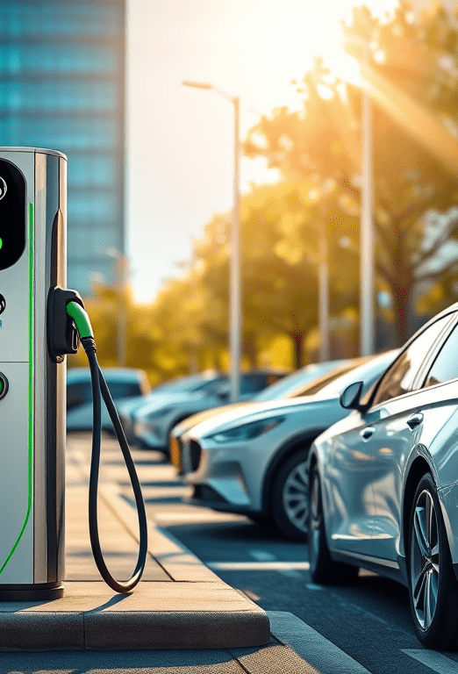

Smart Wireless EV Charging And Billing System
PROJECT GUIDE:-Mrs Asma maam
This project, "Wireless EV Charging using Arduino," aims to design and implement a wireless charging system that can automatically detect a parked EV and initiate the charging process without human intervention. The system is controlled using an Arduino Uno, an hall sensor for vehicle detection, and a relay module to activate the charging coil And the cost is charged accordingly.

Slide 2
OBJECTIVE &COMPONENTS
The system comprises:
Component | Quantity | Purpose
Arduino Nano / Uno | 1 | Main controller
RFID Reader (RC522) + Tags | 1 | Vehicle authentication
IR Sensor | 1 | Vehicle presence detection
Relay Module (5V) | 1 | Control wireless charger
Wireless Charging Module | 1 | Power transfer to EV battery
Real-Time Clock (DS3231) | 1 | Track charging duration
16x2 LCD Display (I2C) | 1 | Show UID, time, and billing info
EEPROM (built-in or external) | 1 | Store billing records
5V Adapter | 1 | Power supply
Jumper wires, breadboard | — | Connections
The objective of this project is to develop a wireless EV charging station that can automatically detect an EV and initiate charging using an Arduino based control system

Slide 3
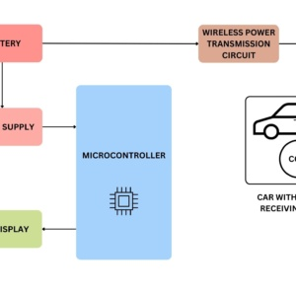

METHODOLOGY
Step 1: Power supply
Step 2: Wireless Transmission Setup
Step 3: Vehicle Detection
Step 4: Charging Activation
Step 5: Monitoring and Control
Step 6:
Billing System
Vehicle detection → RFID scan → gate opens → charging starts → billing displayed.

Slide 4
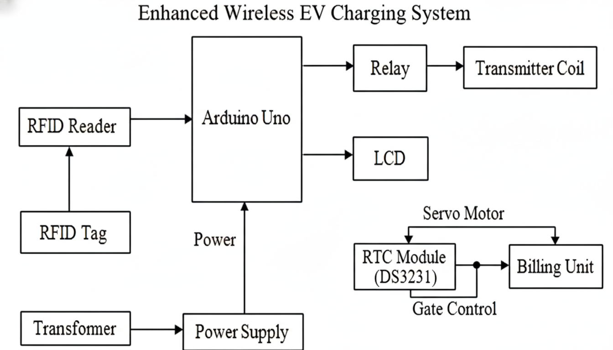
BLOCK DIAGRAM

Slide 5


SYSTEM WORK FLOW
Authorization: The user presents the RFID Tag to the RFID Reader.
Control: The Arduino Uno processes the ID.
Access: If authorized, the Arduino sends a signal to the Servo Motor via the Gate Control line to open the gate.
Charging Start: Once the EV is in position, the Arduino activates the Relay, which sends power to the Transmitter Coil, starting the wireless charging process. Simultaneously, the Arduino records the Start Time from the RTC Module and displays "Charging" on the LCD.
Charging End & Billing: When the charging stops, the Arduino records the End Time from the RTC. The Billing Unit calculates the total cost based on the duration, and the total cost is shown on the LCD.
Exit: The gate opens (controlled by the Servo Motor) to allow the EV to exit.
This Photo by Unknown Author is licensed under CC BY

Slide 6
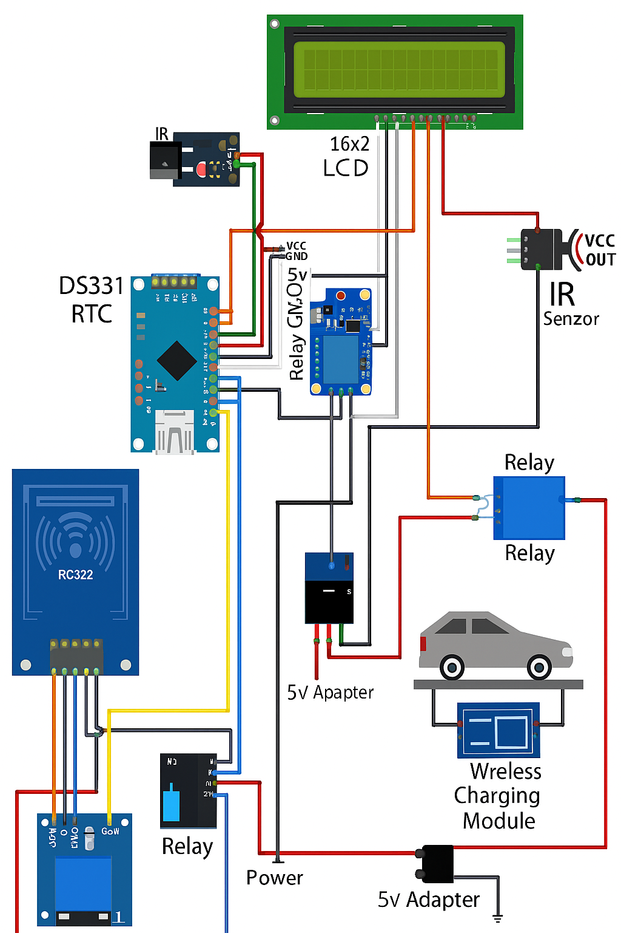
PIN DIAGRAM

Slide 7
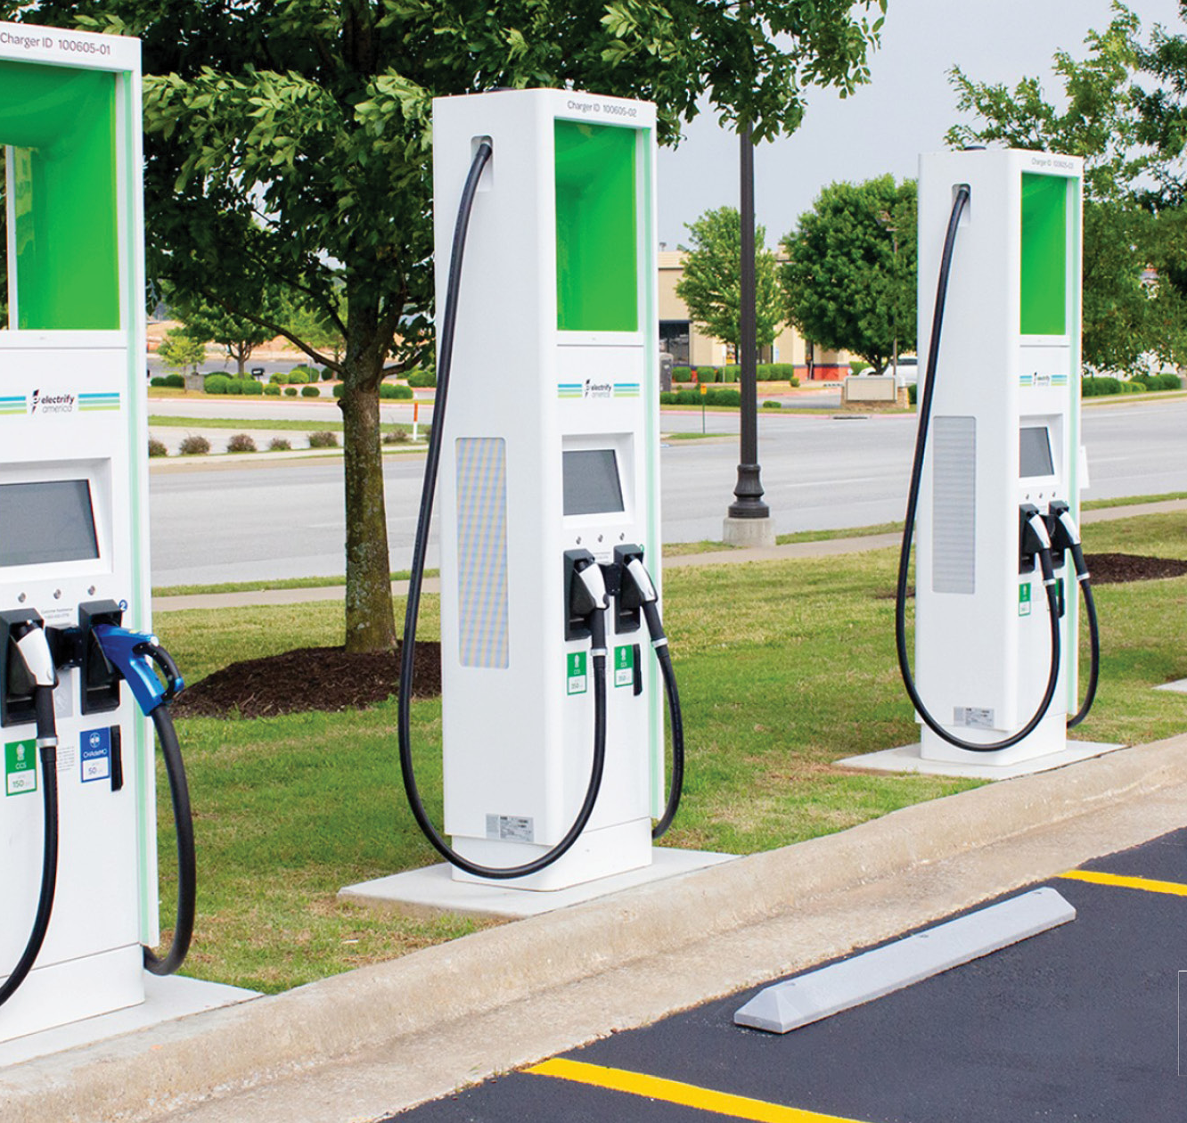

CORE FEATURES
RFID-based vehicle authentication
IR sensor for vehicle detection
Wireless charging activation via relay
Real-time clock (RTC) for accurate time tracking
Billing calculation based on duration
LCD display for showing UID, time, and cost
EEPROM for storing billing logs
This Photo by Unknown Author is licensed under CC BY-SA

Slide 8

CONCLUSION
The Wireless EV Charging System using Arduino demonstrates an efficient, contactless method for charging electric vehicles.
Overall, this system represents a step toward smart, automated, and sustainable EV infrastructure, paving the way for next-generation transportation solutions

